Slide 1
Hiring Process Analytics Statistics
By LAVANYA B

Slide 2
Project Description
The hiring process is a crucial function of any company, directly impacting its growth, productivity, and workforce dynamics. As a Data Analyst in a multinational company, I undertook this project to analyze key hiring trends such as rejection rates, interview distributions, job types, and salary structures.
This analysis aims to provide actionable insights to streamline and optimize the hiring process.

Slide 3
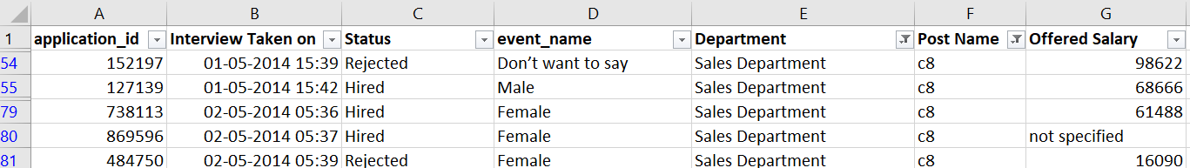
Approach
To ensure a clean and structured dataset for meaningful analysis, I followed these key steps:
Data Preparation & Cleaning
Before conducting the analysis, I focused on refining the dataset to remove inconsistencies and inaccuracies. The steps included:
1. Handling Missing Data: Filling or removing missing values to ensure completeness.
The below attached snap of excel is the missing value in offered salary column in only one row of the whole table. I used Find and select – go to special – Blank, then I got the missing value.
How I handled : Though the status is hired, I can’t delete the row, so I given “not specified”
And also filled “ don’t want to say” in the missing place in the gender – event_name column.

Slide 4


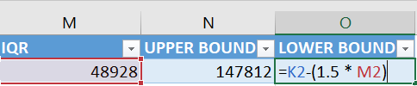



2. Clubbing Columns: Merging similar categories for better clarity.
For this I would like to have the table data column as it is without clubbing.As all the columns are unique on its own and need this as separate columns .
3. Outlier Detection: Identifying extreme values that might distort results.
Outlier done with “Interquartile Range (IQR)" method.
1st I identified Q1 and Q3 by “=quartile()” function in salary column.
Q1 = 25492 , Q3 = 74420
2nd I calculated IQR value. IQR = Q3 – Q1. IQR = 48928
3RD I calculated upper bound and lower bound.
Upper bound = Q3 + (1.5 * IQR) = 147812
Lower bound = Q1 + (1.5 * IQR) = - 47900

Slide 5
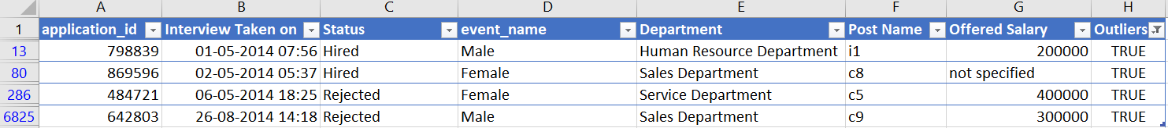
Outliers result: These are the outliers which shows “TRUE”.
4. Removing Outliers: Ensuring a balanced dataset by eliminating anomalies.
Here I removed “Rejected” as status row data. As this doesn’t want in table for further analysis.
And I kept 2 rows which having “Hired” as status. Above snap for reference.
5. Data Summary: Verifying dataset integrity before further analysis.

Slide 6
Tech-Stack Used
Microsoft Excel 2019 – Used for data cleaning, analysis, and visualization.
Excel Functions & Formulas – Applied functions like AVERAGE(), COUNTIF(), SUMIFS() and QUARTILE() for precise calculations.
Pivot Tables & Charts – Created visual representations for better insight delivery.

Slide 7
Insights
The analysis led to valuable insights into the hiring process, helping HR teams make data-driven decisions. The key insights include:
Understanding gender distribution among hires.
Determining average salary offerings.
Visualizing salary distribution patterns.
Identifying department-wise employee proportions.
Categorizing positions into tiers for better workforce planning.
(Each task is detailed in the next sections with Excel snapshots.)

Slide 8

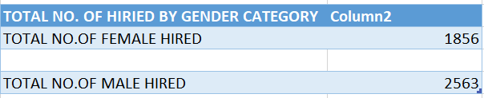
Task-Based Analysis A. Hiring Analysis (Gender Distribution)
Objective:Determine the number of males and females hired in the company.
Used Excel’s COUNTIFS() function to filter and count gender-based hiring numbers.
Insight:
The company exhibits a male-dominated hiring trend.

Slide 9

B. Salary Analysis (Average Salary Calculation)
Objective: Calculate the average salary offered.
Used SUMIFS() and COUNTIFS() function on the salary column.
Insight:
The average salary offered provides a benchmark for future hires.
High variation suggests differences in job levels or departments.

Slide 10
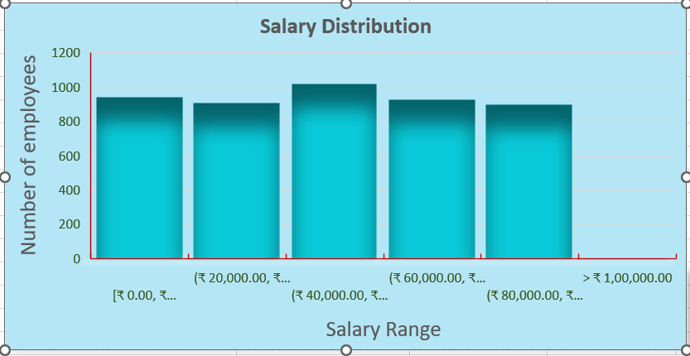
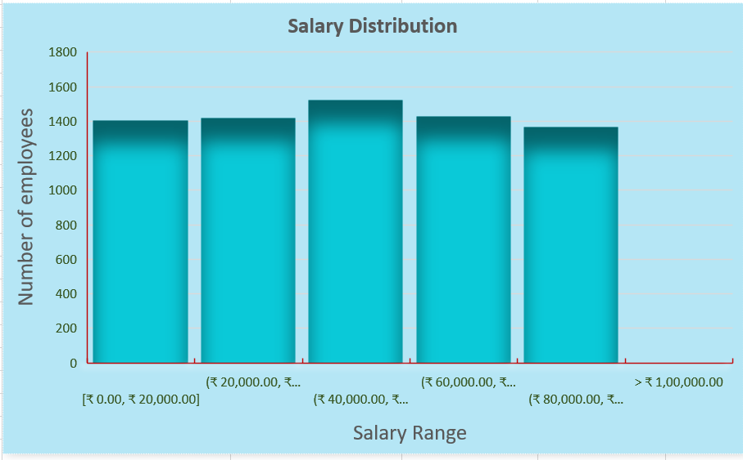
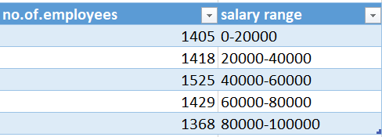
C. Salary Distribution (Class Intervals)
Objective:
Create salary class intervals to understand distribution patterns.
Used Bin Width in Histogram graph to classify salaries into intervals.
Filtered- hired
Without filtering status column
Bin width – 20,000.

Slide 11
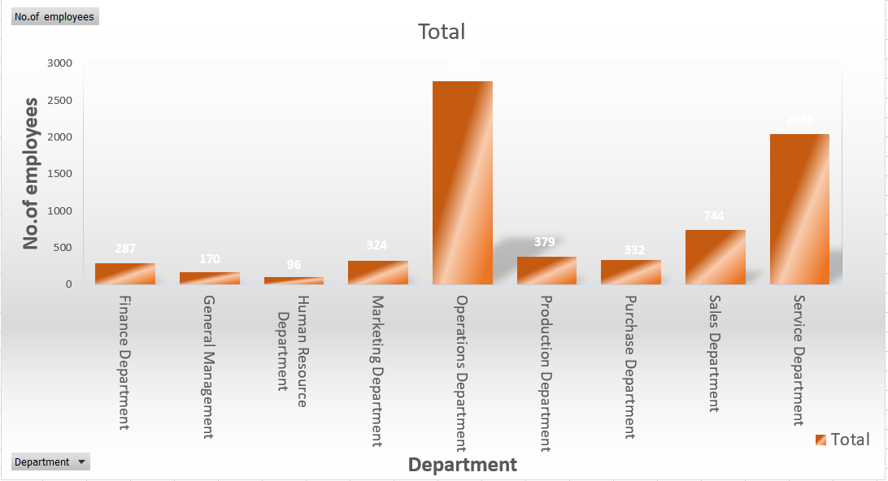
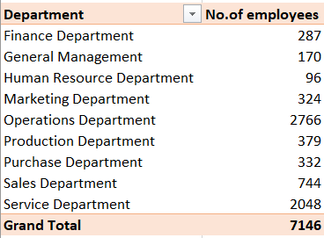
D. Departmental Analysis
Objective: Visualize employee distribution across departments.
Used Pivot Tables and a Column Chart to represent department-wise hiring.
Insight:
Certain departments such as operations and service departments have higher hiring rates, indicating growth or high turnover.
Departments with lower hiring may need recruitment attention.

Slide 12
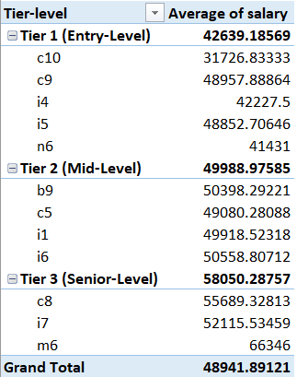
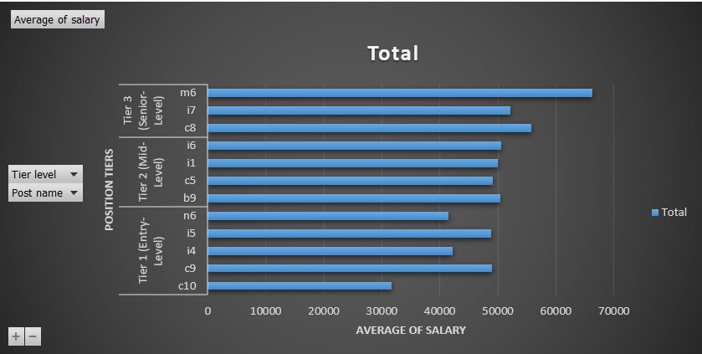
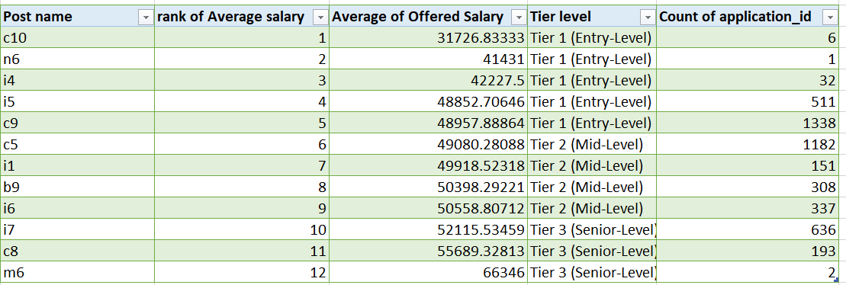
E. Position Tier Analysis
Objective: Understand the distribution of different positions across tiers.
Categorized positions into tiers based on their classification.
Used Pivot Table and Bar chart to visualize distribution.
Insight:
Majority of roles are Tier 1- Entry level positions, with fewer Mid-level hires.
Helps in workforce planning and promotion strategies.

Slide 13
Result
Through this project, I gained a comprehensive understanding of the hiring process, identifying key trends that impact HR decision-making. The analysis offers practical recommendations for improving hiring efficiency, salary structuring, and workforce diversity.

Slide 14
Drive Link
Excel File & Project Report – ( click here to get excel file )
This report will be available for reference and further refinements.

Slide 15
THANK YOU
I hope this analysis provides meaningful insights that can enhance the hiring strategy and decision-making process.
Thankyou for given the opportunity to work on this project.
This analysis highlights the power of data-driven decision-making in hiring strategies.
BY LAVANYA B

